Slide 1
New approaches to managing access to sensitive data
Mandy Chessell
Egeria Maintainer
Chris Nott
Egeria Contributor
Moya Brannan
Egeria Contributor
ODPi Egeria Community

Slide 2
What happens when you need your data scientist to repeatedly work with your most valuable and sensitive data? How do you prevent them from seeing more than they need whilst ensuring that they have a productive and enabling work environment. In this webinar we look at 3 different approaches to managing secure access to data sets that include the most personal and sensitive data. In each approach we use increasing automated means to create selective access to an employee data set that includes correlated personal, performance and financial information. The technology involved is all open source and includes ODPi Egeria, Apache Avro and Palisade. Together they will change the way you think about access control

Slide 3
Callie is a data scientist … and an employee
Callie Quartile is a Data Scientist working for Coco Pharmaceuticals. She is an experienced, ethical worker, but still she is only human which makes her curious…
Coco Pharmaceuticals needs her to work on a number of projects that make use of their employee data.
How do they secure their employee data so that Callie has enough access to do her job, without revealing everyone’s personal, financial and performance information to her?
Callie Quartile

Slide 4
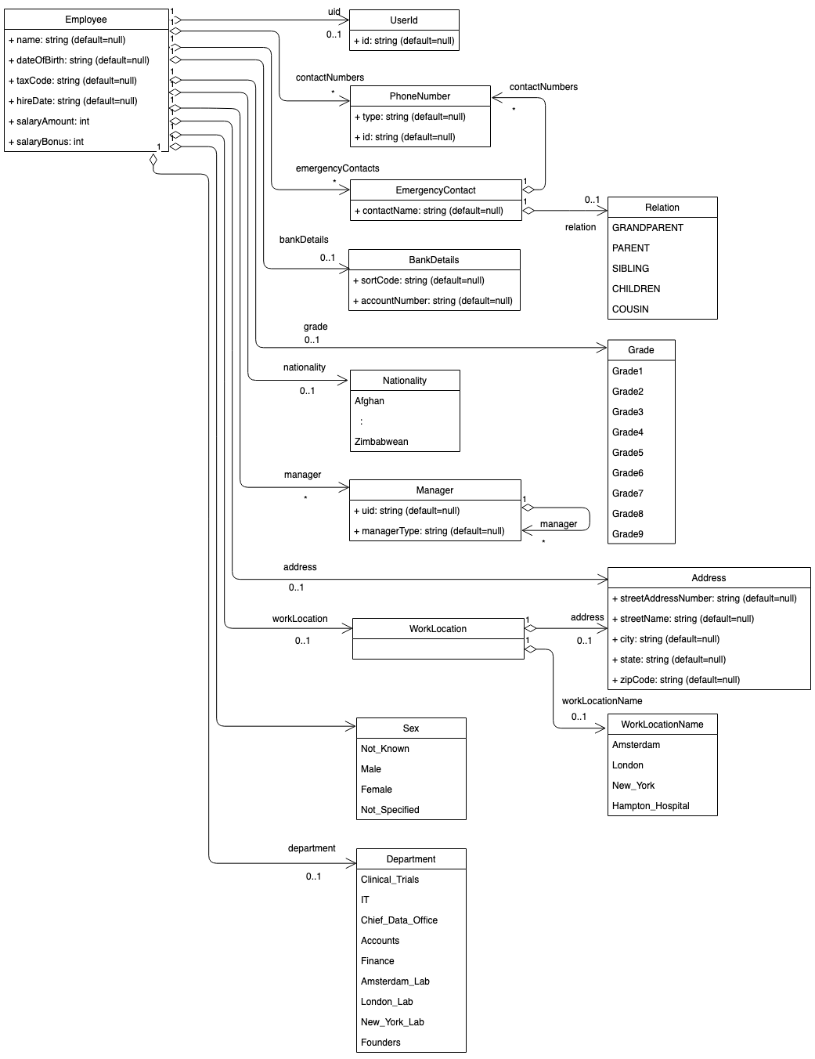
Beyond the limits of asset labeling
Employee data is a complex mixture of public, personal, confidential and financial information.
It needs to be labeled (tagged) to show where these different types of information are located.
The labels then guide people and the IT processes that work with the data on how it should be handled,
However labels alone are not enough to control access.

Slide 5
Consider the different reasons that Callie needs access
Company Directory – read access to contact and organizational information about her colleagues.
Personal Profile Maintenance – update her own employee record (and no-one else’s).
Data science projects
Health screening project – locate employees with > 5 years service and invite to optional health screening program – needs read access to name and contact information of all employees along with their start date at Coco Pharmaceuticals.
Salary analysis project – identify biases in the salaries of Coco Pharmaceutical’s employees based on their age, gender or location – needs read access to anonymized records of employees containing demographic and salary information.

Slide 6
Callie’s project-appropriate access to employee data
Project
Employee
Health
Screening
Selective read
queries
Name
Start date
Salary Analysis
Contact
Selective anonymized read
Demographic
Salary

Slide 7
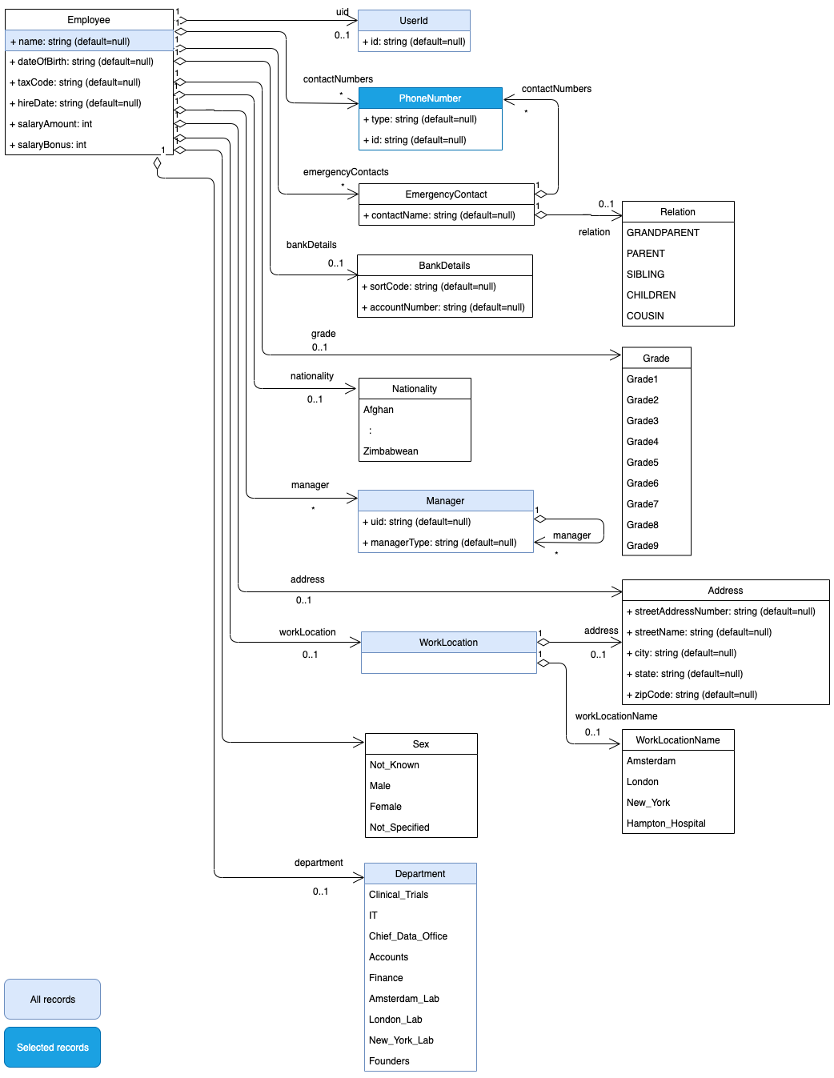
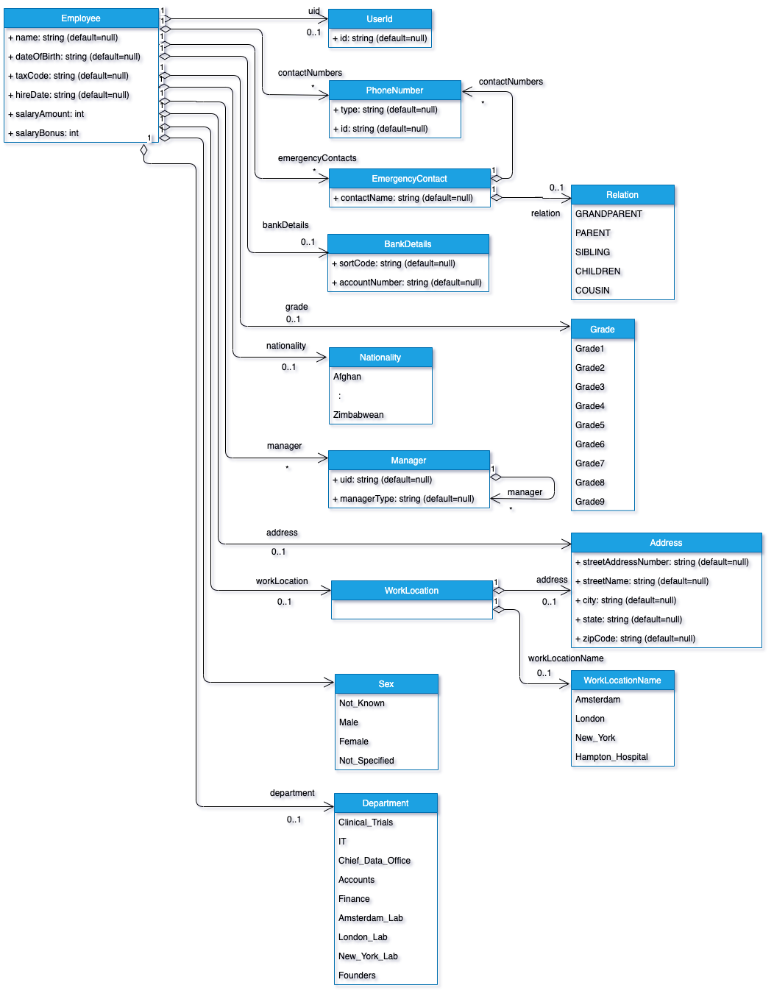
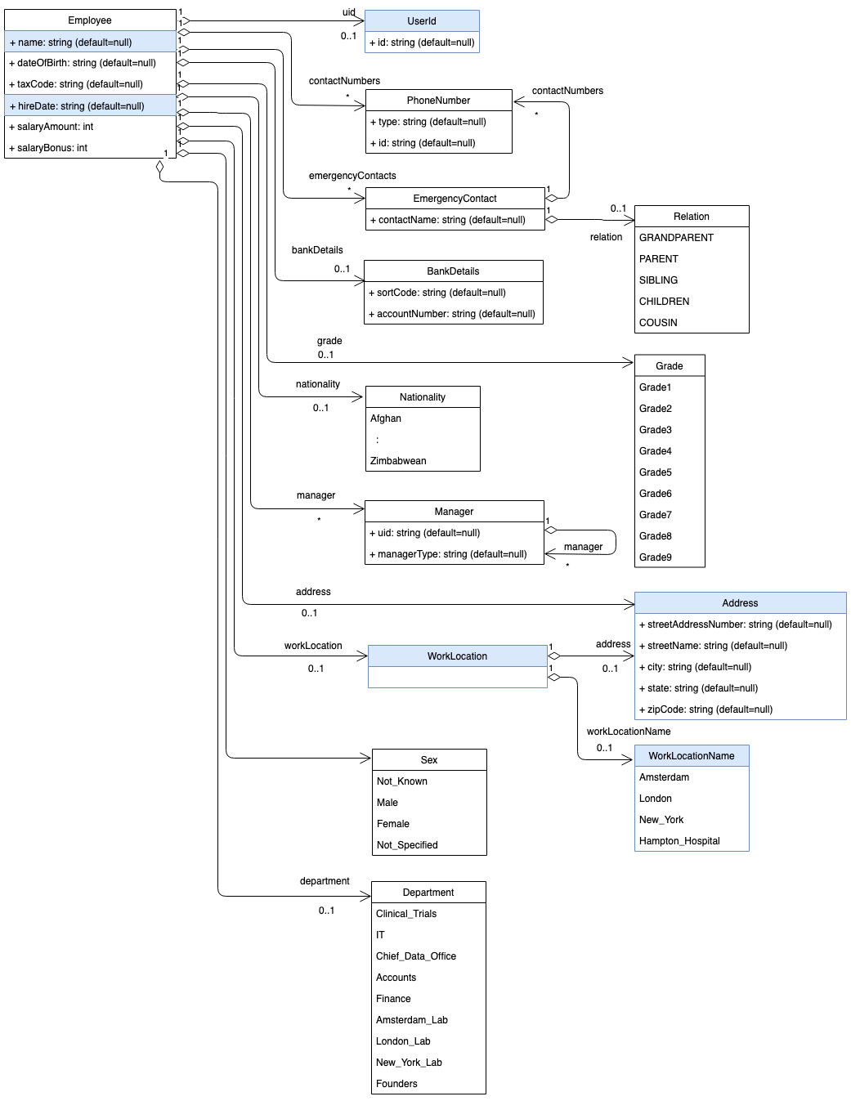
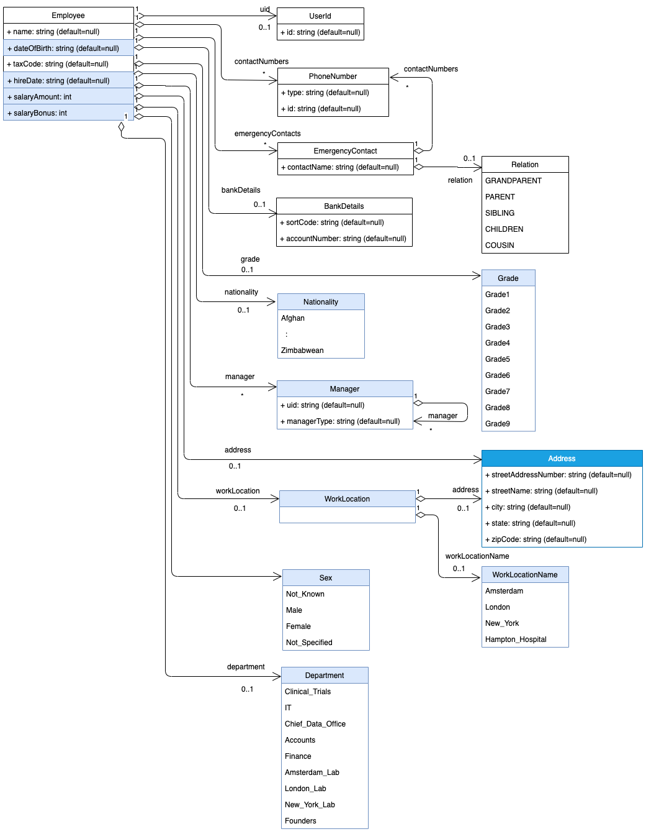
Each purpose requires a different subset of data
Company Directory
Personal Profile Access
Health Screening
Salary Analysis
In combination, they give Callie access to too much data!

Slide 8
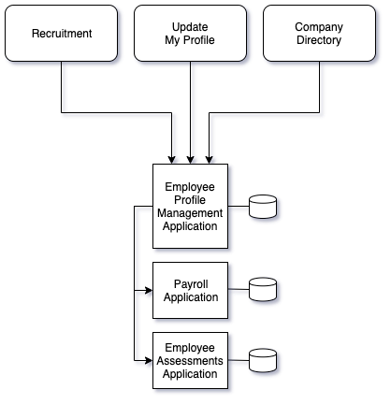
The importance of applications
Applications provide services around data.
Their function assures access to data and we would expect the company directory and the update of an employee’s personal profile to be handled by applications.
Updates to data are often shared between applications in point to point data flows.

Slide 9
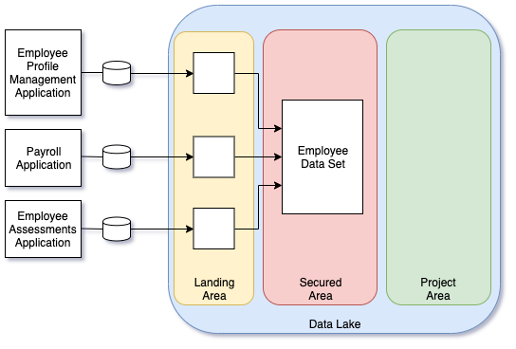
Using a data lake for data science
Applications are purpose built to provide specific services. They typically do not keep historical data, nor support the ad hoc query load created by data scientists.
A data lake provides a collection of governed data platforms that collect data from applications, building a historical record of the data. Processes inside the data lake transform and combine the data into new data sets for later processing.
Since the data lake collects data from many places, it manages data ranging from public to highly sensitive and from low value to high value. Therefore it needs tight controls on who/what is using which data.

Slide 10
Creating the protected shell
Data without its application is like a tortoise without its shell
Knowledge and action (to scale)
Metadata captures the knowledge
Metadata driven technologies provide the action
Automation is needed to keep costs down and to ensure action is complete and consistent
Business agility is critical
Flexibility to change actions
Enable the adoption of new technologies and techniques as appropriate.
From http://rlv.zcache.com/cute_shell_less_cartoon_tortoise_sticker-r80fe767295c64fa59f0684bc711e9a25_v9waf_8byvr_512.jpg

Slide 11
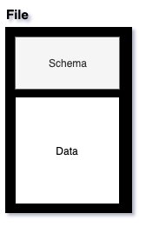
What is Apache Avro?
http://avro.apache.org/
Apache Avro is a data format often used in data lakes.
It supports storing data as files, or as messages in the event feed.
The schema format of the data is associated with the data. For files it is stored within it. This is valuable in a data lake as application and analytical schemas are evolving all of the time.
Coco Pharmaceuticals is using Avro for the files stored in its data lake.

Slide 12
ODPi Egeria and metadata management
ODPi Egeria is an open source distributed metadata management capability. Coco Pharmaceuticals uses it throughout its IT systems to manage its metadata. In the data lake, there is an Egeria metadata server plus various governance servers managing the metadata for various data movement and quality engines.
The metadata server provides a catalog of the data in the data lake. It links to the metadata server used by the governance team to manage the governance requirements for data and this is used by the governance servers to govern the usage of data in the data lake.

Slide 13
What does metadata look like?
Business
metadata
IS-A
Employee
Sensitive
HAS-A
Work Location
HAS-A
HAS-A
Hourly Pay Rate
Manager
Compensation Plan
HAS-A
IS-A
HAS-A
Job Title
IS-A
HAS-A
Employee Id
Annual Salary
Employee Name
Structural
metadata for
a data store
EmpName
EmpNo
JobCode
Salary
Employee Record
Data
00 3809890 6 7 Lemmie Stage 818928 3082 4 New York 4 27 DataStage Expert 1 45324 300 27 Code St Harlem NY 1 3
Notes:
Business metadata describes the data that the business needs, what it means and how it should be classified and protected.
Structural metadata describes how the data is actually stored and labelled in the data store.
The linkage between the business and technical metadata allows our technology to switch between these two perspectives. For example,
A request for data expressed in business terminology can be translated into a query for data from a data store.
An integration engine copying data into a sand box can discover which are the fields that the business classifies as sensitive and then mask these values dynamically.

Slide 14
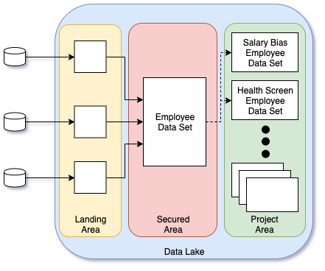
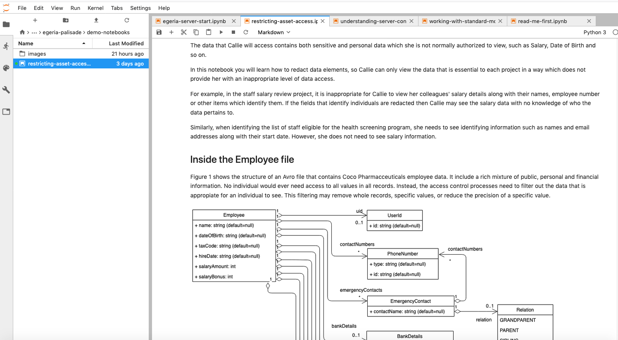
Creating data subsets using Avro files
Most access control mechanisms focus on who the user is when assessing what data to return from a specific asset.
Coco Pharmaceuticals needs to create subset copies of the employee data set that Callie may access for each of her projects.
This approach is simple, but it leads to delays as a new copy of the data set is provisioned, plus a proliferation of this potentially sensitive data. Every copy needs to be maintained.

Slide 15
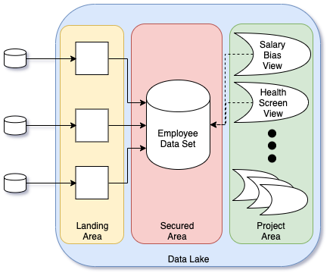
Using a data virtualization service
Data virtualization tools that support different views over the data reduces data copying, but still requires admin action to create and maintain the views over the data.
Data Virtualization

Slide 16
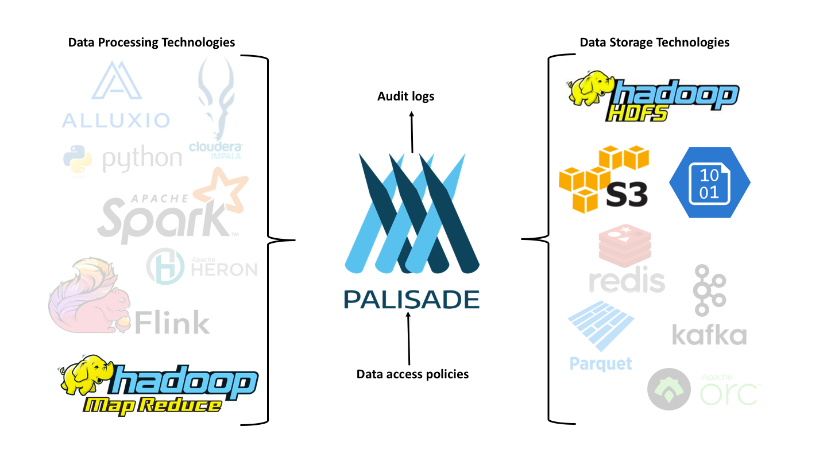
Introducing Palisade
https://github.com/gchq/Palisade
Palisade is an open source project that provides Policy and Access Enforcement Services (PAES).

Slide 17
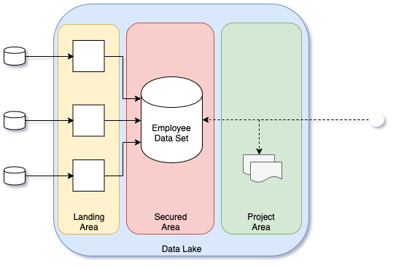
Working with purpose
Palisade allows the use of broader contextual information in the evaluation of a query.
This contextual information combines the user information with additional query time properties.
Query time properties include the origin and purpose of the query
With this approach the application of the access policy to the query considers the broader context of the request.
This means that different subsets of the data are automatically returned when Callie issues a query depending on the context she selects - without the need to duplicate data or configure explicit views.

Slide 18
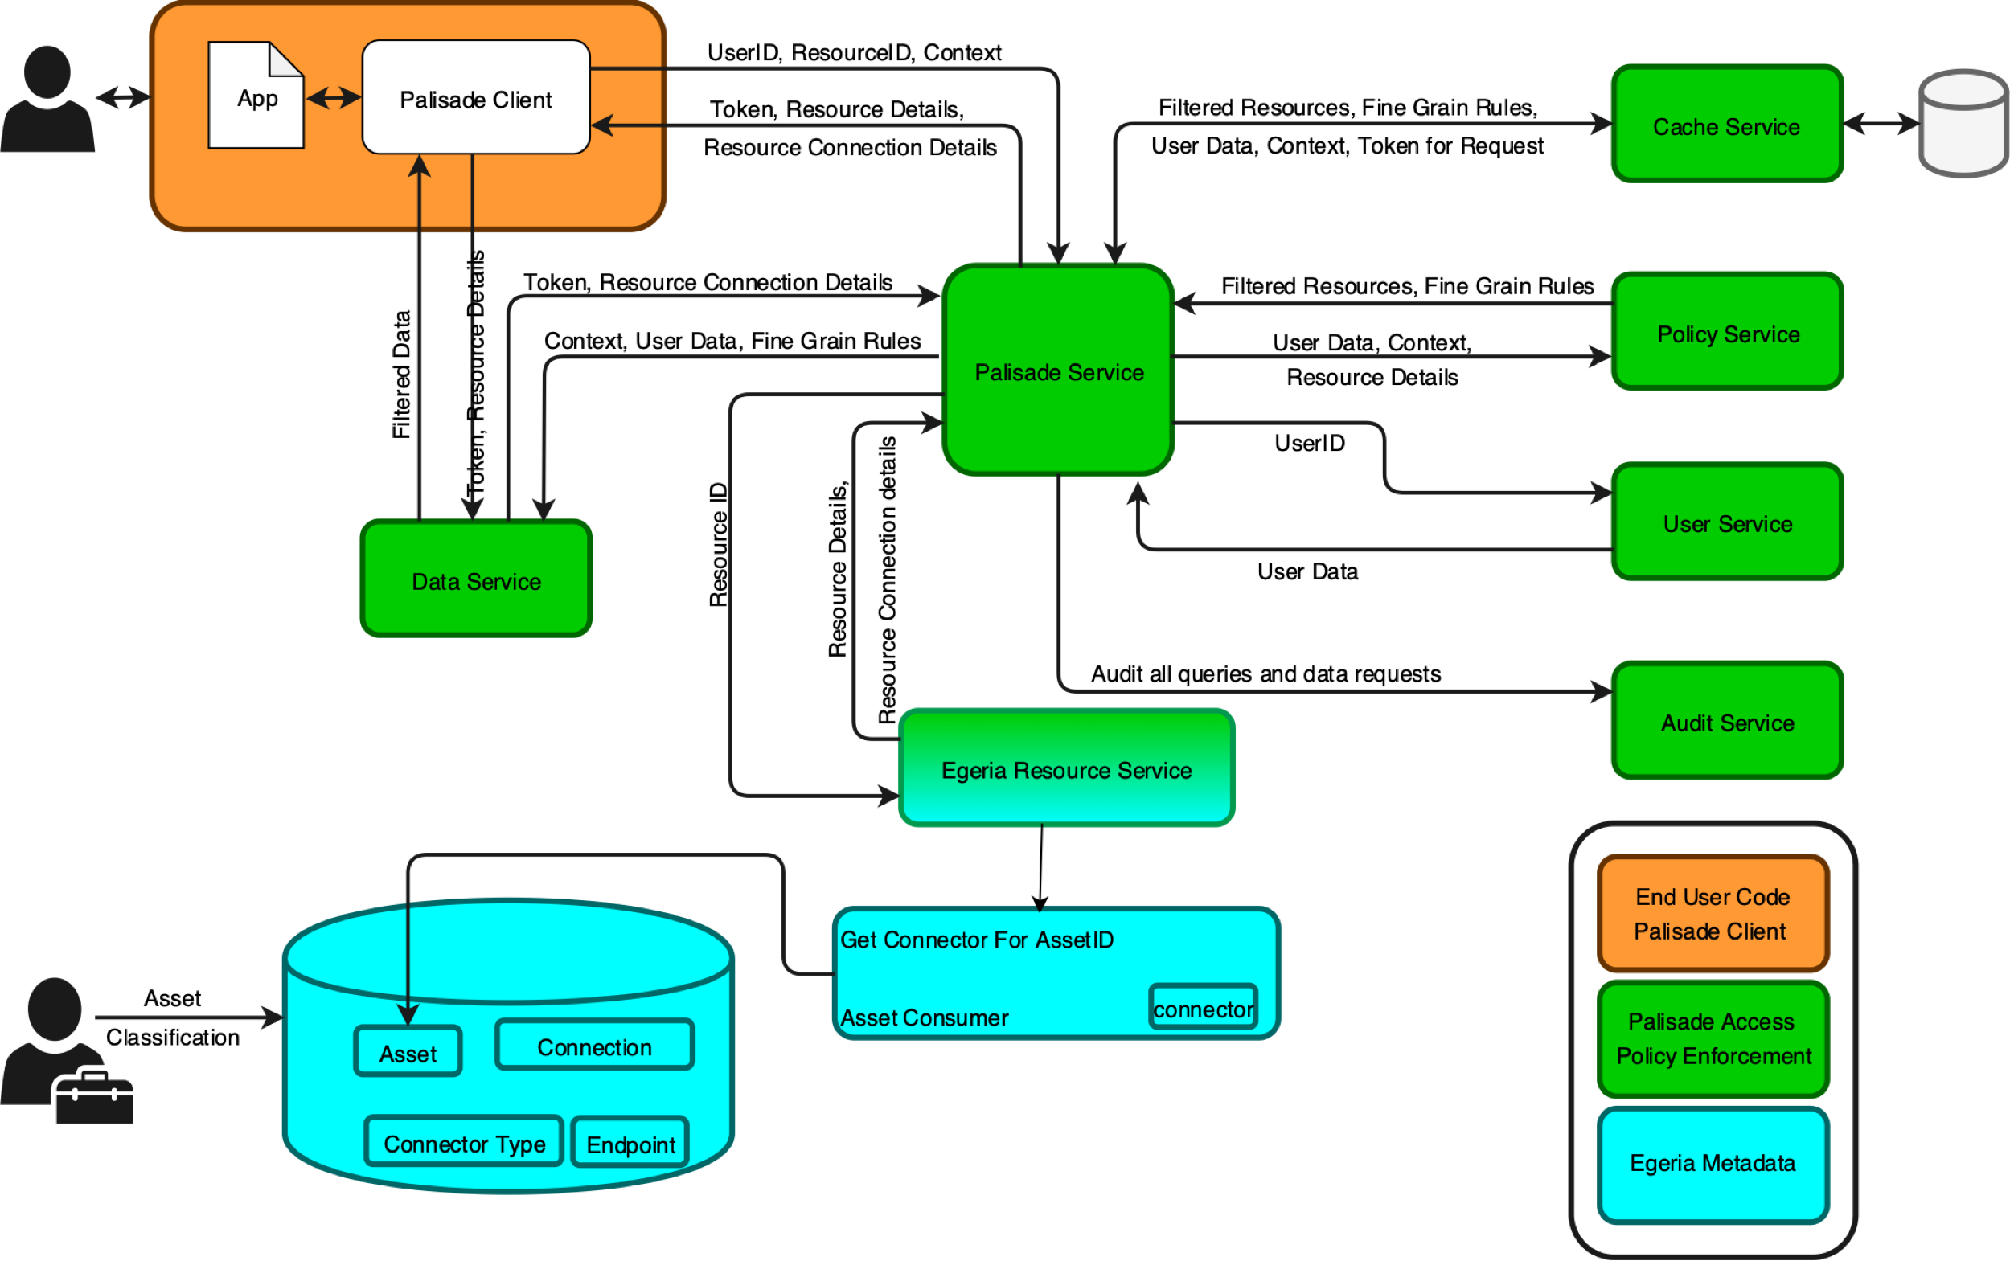
Solution architecture

Slide 19
Demo

Slide 20
Summary
Data lakes manage a mixture of public through to sensitive data.
Special care is needed to ensure no-one sees more data than they need.
Often this is ensured by making subset copies of the data, or by creating managed views over the data to control what is visible.
Adding the ability to capture the context of a query, means that the origin and purpose of the data access can be dynamically factored into the request – enabling query time filtering of the schema and the data.
This reduces the copying of data and/or administration of views allowing the organization to react quickly to new types of requests for data.

Slide 21
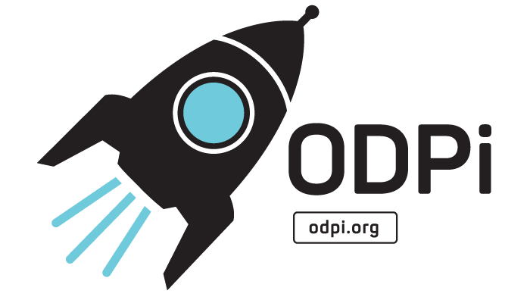
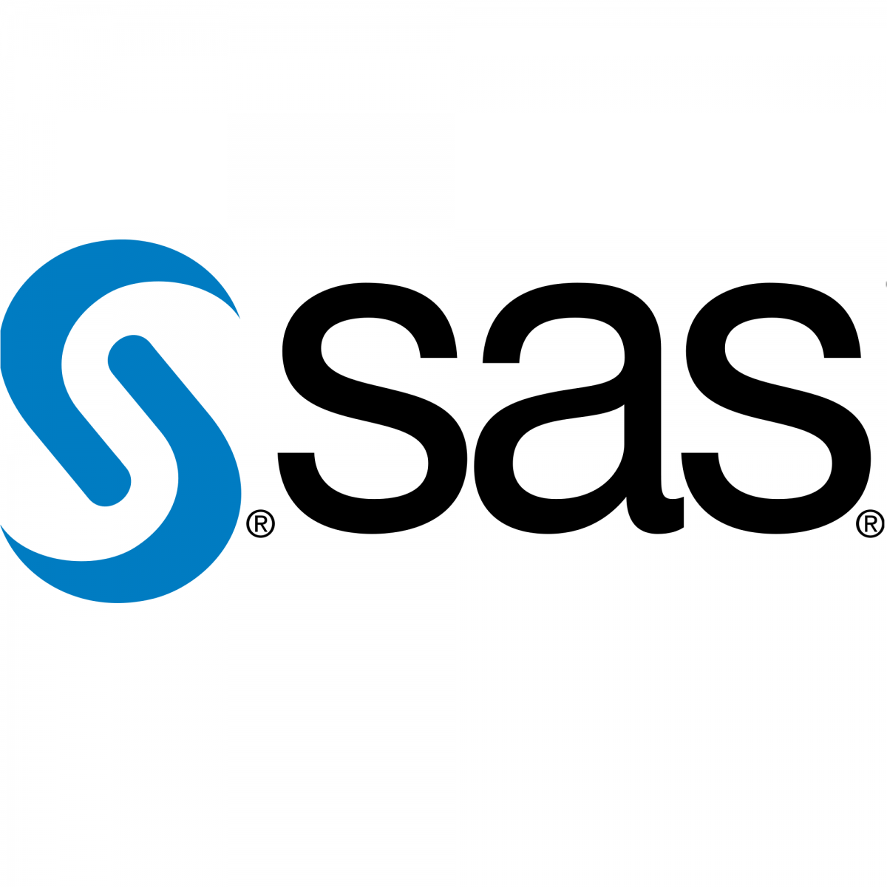
The ODPi foundation is part of The Linux Foundation
Delivering core technology
Recruiting vendors
Assisting practitioners
Core Technology
Vendors
Project
Egeria
Conformance Suite
Practitioners
Best Practices
Project
Data
Governance

Slide 22
Taking the next step with ODPi Egeria
Kubernetes/Docker deployment
Hands on labs
Coding samples
Guidance on governance
Governance Teams
Policy
Policy
Audit
Define
Asset Owners
Enterprise Architecture
Monitor
Policy
Roll out
Classify
Operations
Policy
Metadata
Development
Stewards
Design
Execute
Business Users
Deploy
Developers
Detect
Remediate
Develop
Data Scientists
DevOps

Slide 23
Open forum
z
z
z
z
z
z
z
Questions?

